Slide 1




Slide 2


WELCOME TO SINGAPORE
No.of Listings
3146
No.of Hosts
869
No.of Neighborhoods
45
http://insideairbnb.com/

Slide 3
QUESTION
How To Attract More Customers For Rental Property?
AUDIENCE
People Who Own Property In Singapore
Roomtype, Accommodation & Price
1
FEATURE
Amenities
2
Name, Description & Neighborhood Overview
3

Slide 4
High-performance listings
Low-performance listings
10% highest number of reviews
10% lowest number of reviews
No.of Listings
327
No.of Listings
1455

Slide 5
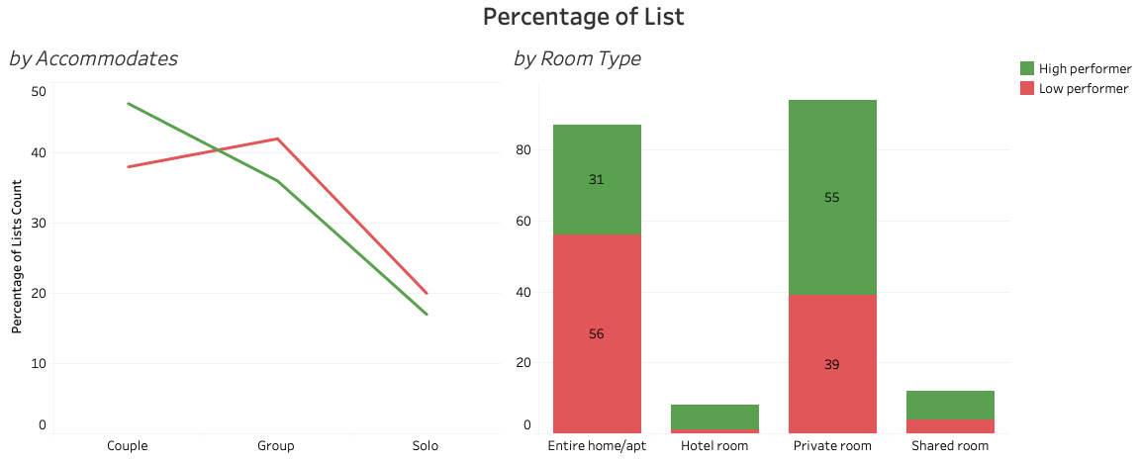
1. Roomtype, Accommodation & Price
High-performance listings consist of more private room for couples than low-performance listings

Slide 6
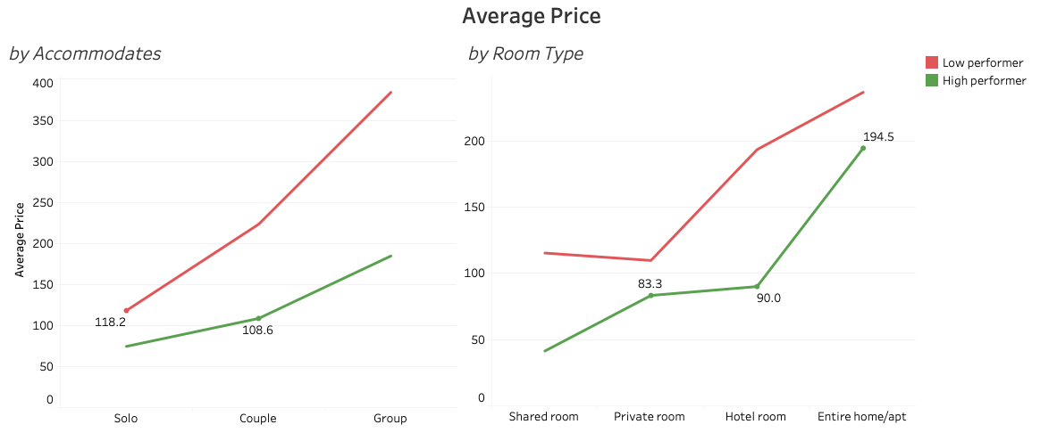
High-performance listings have lower price than low-performance listings

Slide 7
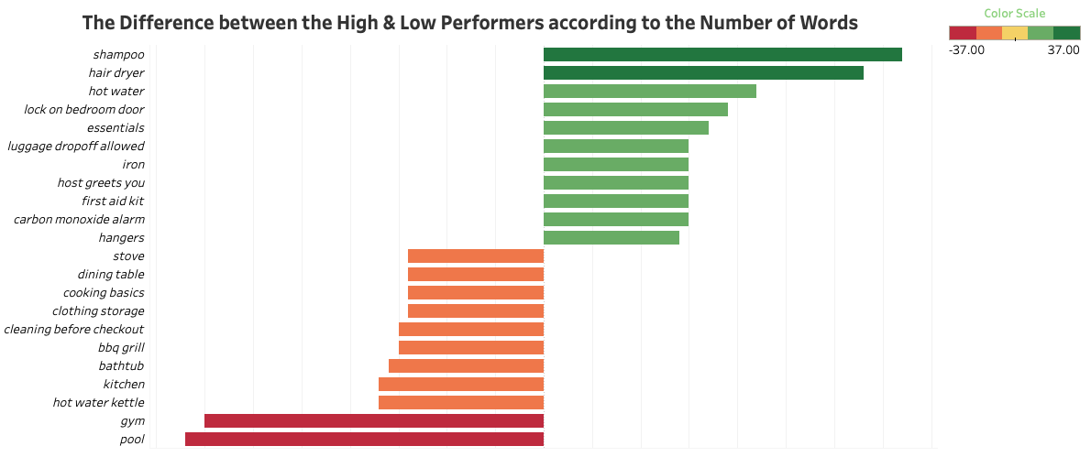
2. Amenities
Listings with essential amenities have more reviews than listings with High-class amenities

Slide 8
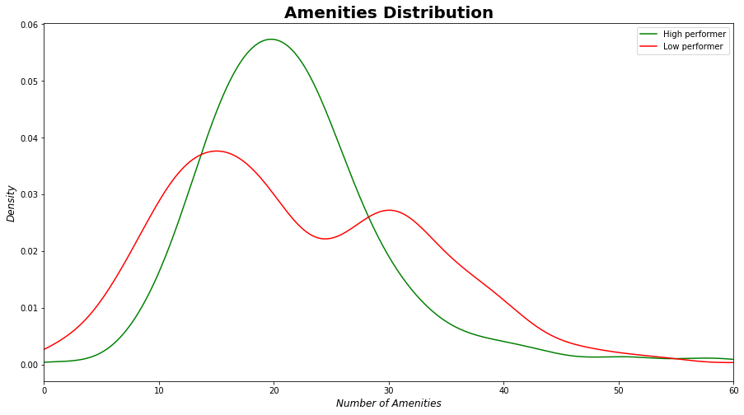
Is it true that the more amenities the better ?

Slide 9
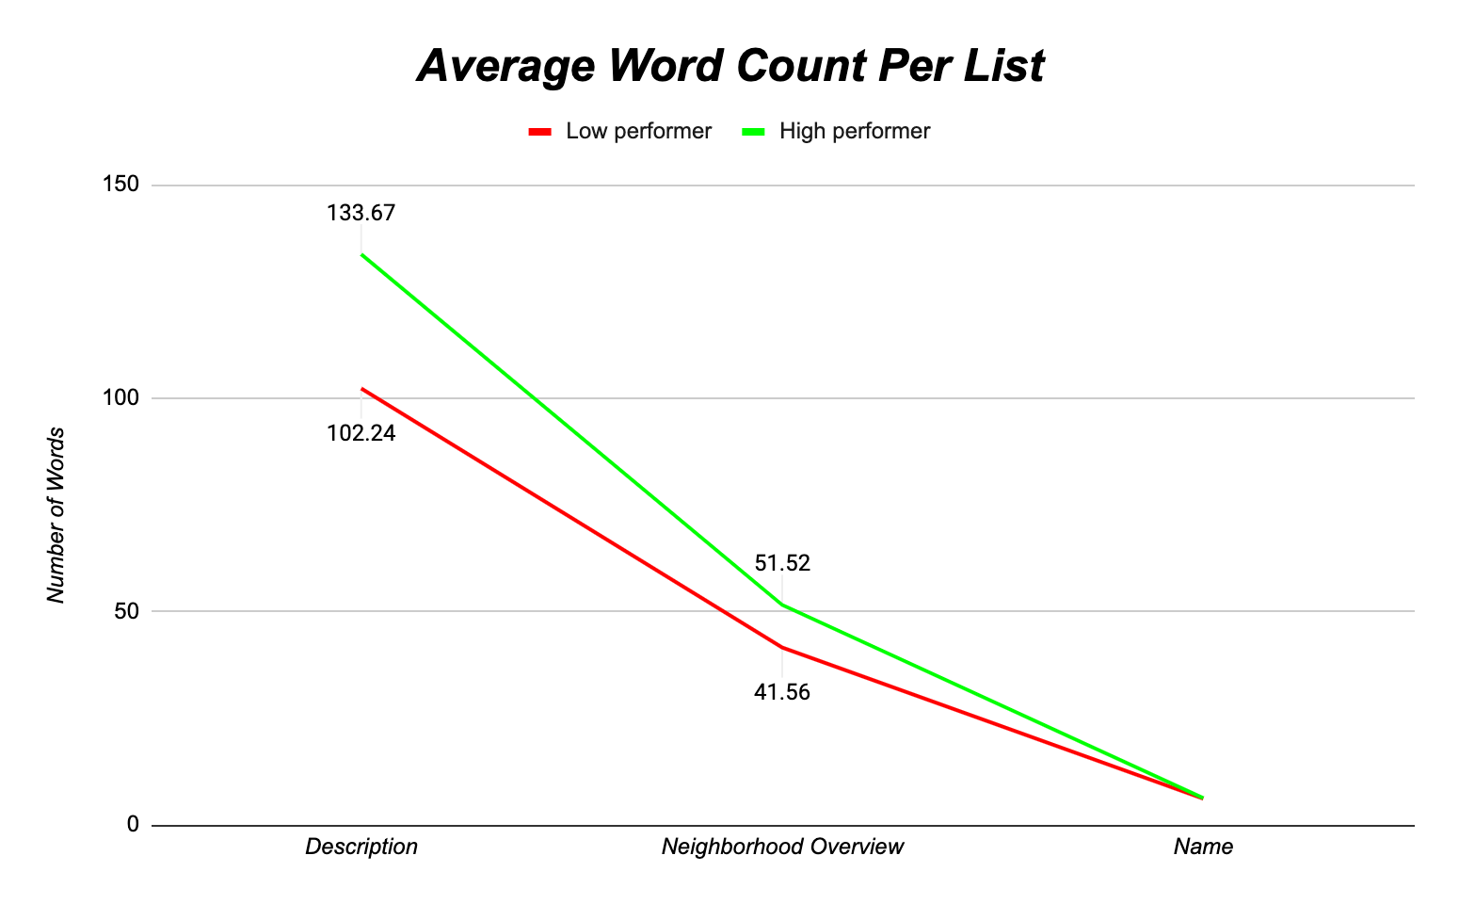
3. Name, Description & Neighborhood Overview

Slide 10
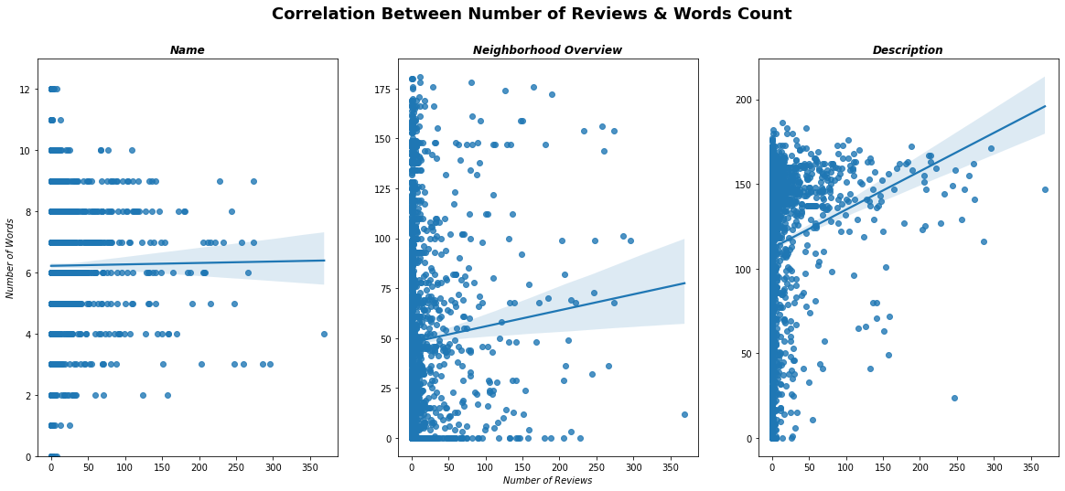
High-Performing Listings Have More Detailed Descriptions

Slide 11
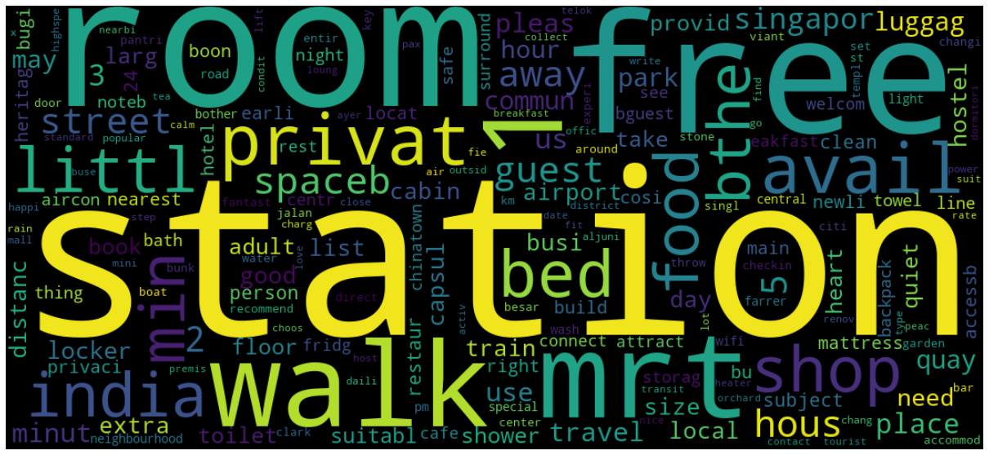
Where is the best location of Lists ?

Slide 12
CONCLUSION
1
The lower price, the higher reviews
Private room for Couple is the best choice for hostings
2
Listings with essential amenities have more reviews than listings with High-class amenities
20 is the best number of amenities
3
High-performing listings are near subway stations and within walking distance of food stores & shopping malls
People prefer more free offers (Free Wifi, Free Parking)

Slide 13
THANKS FOR YOUR LISTENING

